Slide 1
Classification Problems
Lecture 9

Slide 2
Shameless Plug for Workshops

Slide 3

Friday, September 6th
National Food Bank Day
National Read a Book Day
National Coffee Ice Cream Day

Slide 4
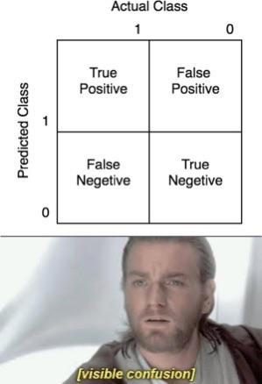
Assignment 2
Input/Output features
Confusion Matrix
Domain Expertise
https://www.reddit.com/r/ProgrammerHumor/comments/122yy2l/image_classification_gets_confusing/

Slide 5
Accuracy
# of correctly predicted labels/total number of instances
Great metric, not the most nuanced per-class

Slide 6
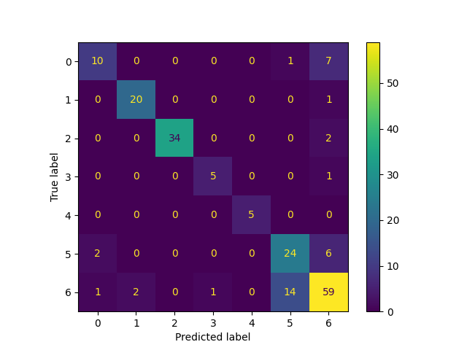
Confusion Matrix
Popular in classification problems
Looks at different prediction metrics, per-class

Slide 7
True Positives
Predicted an instance of a class
And was actually an instance of that class

Slide 8
False Positives
Predicted an instance of a class
And was not actually an instance of that class
Red squares are false positives for class 6 (predicted label was 6, but true class was not 6)

Slide 9
True Negatives
Was not predicted as an instance of a class
Was actually not an instance of that class

Slide 10
False Negatives
Was not predicted as an instance of a class
Was actually an instance of that class
Red squares are False Negatives for class 6 (true class 6, predicted label not 6)

Slide 11
Another example
These are false positives for class 0 (predicted 0, not actually zero)
These are false negatives for class 5 (true label 5, predicted not 5)

Slide 12
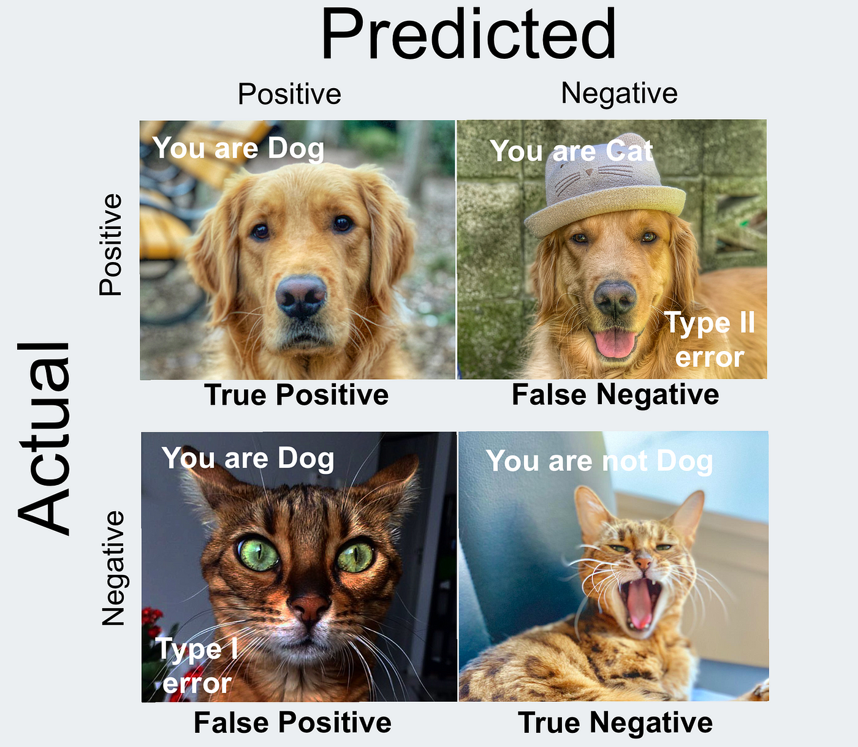
Let's code this
Using our faults example
https://medium.com/@data.science.enthusiast/confusion-matrix-guide-to-evaluate-model-for-a-fintech-case-68bfebbbefbc

Slide 13
Additional Metrics
Per class accuracy: # of correctly predicted labels in class / total number of labels in class
Precision: TP/(TP + FP): What percent of predicted positives were actually positives
Recall TP/(TP +FN): What % of positive classes predicted accurately
F1 Score: 2*(Precision*Recall) / (Precision + Recall) (harmonic mean): Generally, how good you are at *actually* predicting the class
Often used as the metric in classification - rule of thumb > 0.8
Source: https://www.aitude.com/8-important-evaluation-metrics-for-classification-models/

Slide 14
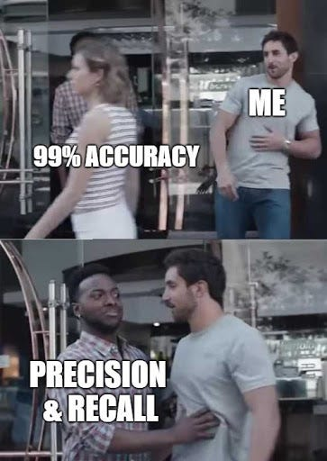
https://medium.com/analytics-vidhya/what-precision-recall-f1-score-and-accuracy-can-tell-you-fe1eab1ada5a

Slide 15
Other Metrics
False Positive Rate (Type 1 error): FP/(FP+TN): What % negative classes wrongy classified
False Negative Rate (Type II error): FN/(FN+TP) what % of positive classes wrongly classified
Specificity: TN/(TN+FP): What % of actual negatives correct
Source: https://www.aitude.com/8-important-evaluation-metrics-for-classification-models/

Slide 16
Going forward
Generally, looking at what class the model performs best on can be informative
For assignments where we are looking at individual classes within a classification problem, likely looking at per-class accuracy or F1 score

